Slide 1
Personalizing Web Search using Long Term Browsing History
Speaker : Po-Hsien Shih
Advisor: Jia-Ling Koh

Slide 2
Outline
Introduction
Personalization Strategies
Evaluation Approach
Conclusion & Future Work

Slide 3
Introduction
The vast majority of search queries are short and ambiguous. Different users consider the same query to mean different things.
Ex. “ajax” Is the cleaning product ajax? Or Dutch football team Ajax Amsterdam ?
Personalized search is a potential solution to all these problems.
We improve upon this work in two key ways:
Building an improved user profile for personalizing web search results.
we improve upon the evaluation methodology.

Slide 4
Introduction
To successfully personalize search results , it is essential to be able to identify what types of results are relevant to users.
(1) Ask users to label documents
(2) Infer personal relevance automatically.
We parse web page structure, using term extraction and extracting noun phrases to refine the user model without any effort and changing search environment.
Using document judgments obtained from a small number of users for 72 queries to assess potential approaches, then select three methods for complete online evaluation.

Slide 5
Personalization Strategies
A user is represented by :
a list of terms
weights associated with those terms
a list of visited URLs
the number of visits to each
a list of past search queries
pages clicked for these search queries
URL | HTML Content
… | …
… | …
Browsing History

Slide 6
Personalization Strategies
User Profile Generation – use to rerank
Data Capture
Data Extraction
Term List Filtering
Term Weighting
Re-ranking Strategies
Scoring Methods
Rank and Visit Scoring

Slide 7
Personalization Strategies -User Profile Generation
Data Capture

Slide 8
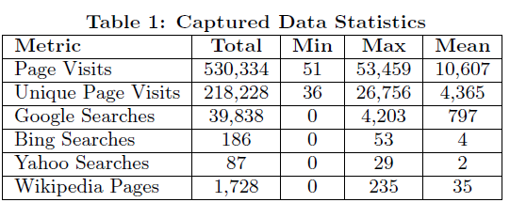
Personalization Strategies -User Profile Generation
Data Capture
Use “Altergo” (A FireFox add-on) to get user browsing records.
A random unique identifier is generated at installation time.(for privacy)
Use Google as the baseline.
URL
Server
identifier
SEND
Date,Time
HTML’s Length
Compare

Slide 9
Personalization Strategies -User Profile Generation
Data Extraction

Slide 10
Personalization Strategies -User Profile Generation
Data Extraction
Full Text Unigrams
The body text of each web page.
Title Unigrams
The words inside any <title> tag on the html pages.
Metadata Description Unigrams
The content inside any <meta name="description"> tag.
Metadata keywords Unigrams
The content inside any <meta name="keywords"> tag.
Extracted Terms
Term Extraction algorithm on the full text of each visited web page. It attempts to summarize the web page's text into a set of important keywords.
Noun Phrases
Taking the text from each web pages and splitting it into sentence using OpenNLP Tool, then using the Clark & Curran Statistical Language Parser which assigns a constituent tree to the sentence and part of speech tags to each word.

Slide 11
Personalization Strategies -User Profile Generation
Term List Filtering
To reduce the number of noisy terms in user representation
-> removing infrequent words or words not in WordNet.
( http://wordnet.princeton.edu/ )

Slide 12
Personalization Strategies -User Profile Generation
Term Weighting

Slide 13
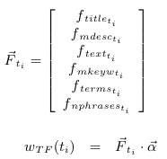
Personalization Strategies -User Profile Generation
TF Weighting
0 : ignore particular field
1 : including particular field
1/ N_{i} :N_{i} is the total number of terms in field i
TF-IDF Weighting
Weight vector

Slide 14
Personalization Strategies -User Profile Generation
Personalized BM25 Weighting
N : the number of documents on the web
(estimated from the Google N-Gram corpus, 220,680,773)
n_{ti}: the number of documents in the corpus that contain the term ti
R : the number of documents in the user's browsing history
r_{ti} is the number of documents in the browsing history that contains this term within the selected input data source

Slide 15
Personalization Strategies –Re-ranking Strategies
Chances are high that even for an ambiguous query the search engine will be quite successful in returning pages for the different meanings of the query. We opt to retrieve and re-rank the first 50 results retrieved for each query.
Scoring Methods
Matching
For each word in the search snippet's title and summary that is also in the user's profile.
N_{si} : the total number of unique words within the snippet's title and summary.
f_{ti} : the number of occurrences of ti within the snippet.

Slide 16
Personalization Strategies –Re-ranking Strategies
Unique Matching
Language Model
N_{si} is the total number of words in the snippet's title and summary.
w_{total} stands for the sum of all the weights within the user profile.

Slide 17
Personalization Strategies –Re-ranking Strategies
PClick
It assumes that for a query q submitted by a user u, the web pages frequently clicked by u in the past are more relevant to u.
|Clicks(q, p, u)| is the number of clicks on web page p by user u for query q in the past.
|Clicks(q,●,u)| is the total click number on query q by u
β is a smoothing factor set to 0.5
Note that PClick makes no use of the terms and weights associated to the user's profile and is only based on click-through data for a given query.

Slide 18
Personalization Strategies –Re-ranking Strategies
Rank and Visit Scoring
To adjust the snippet scores by two ways:
The snippet's original rank r_{si}
This extends PClick in that it boosts all URLs that have previously been visited, while PClick only boosts URLs that have directly been clicked for the current search query.
The number of previous visits to that web page (n_{i}) times a factor v

Slide 19
Evaluation Approach
Step I.
Starting with an offline NDCG based evaluation to pick the optimal parameter configurations
Step II.
Then we evaluate with the more realistic and harder online interleaved evaluation

Slide 20
Evaluation Approach - Offline Evaluation
Reranking Performance
MaxNDCG:
which yielded the highest average NDCG score on the oine dataset;
MaxQuer
which improved the most queries;
MaxNoRank
the method with highest NDCG that does not take the original Google ranking into account
MaxBestPar
obtained by greedily selecting each parameter

Slide 21
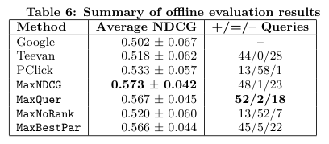
Evaluation Approach - Offline Evaluation
Compare Average NDCG
MaxNDCG & MaxQuer are better than others.
Although MaxNoRank is better than Google,But this maybe a result of overfitting the parameters given our small offline dataset.
Compare numbers of query
How about PClick ? Because PClick only works on repeated queries.

Slide 22
Evaluation Approach - Offline Evaluation
Parameter Effect:
Profile parameter
Ranking parameter

Slide 23
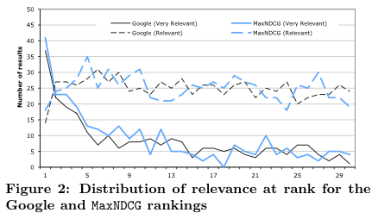
Evaluation Approach - Offline Evaluation
The personalization strategy considers the Google rank and is less aggressive at high ranks.

Slide 24
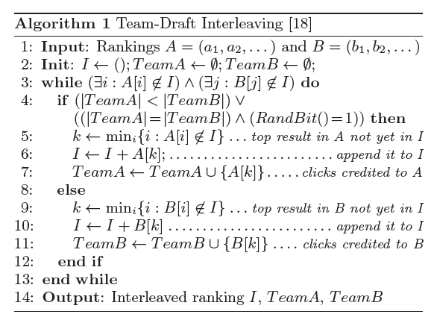
Evaluation Approach - Online Evaluation
Interleaving Implementation
Is used to produce a combined ranking.
To avoid presenting slightly different rankings every time a search page is refreshed.

Slide 25
Evaluation Approach - Online Evaluation
MaxNDCG is best, matching our offline finding.

Slide 26
Evaluation Approach - Online Evaluation
The Unchanged column indicates the number of queries for which the clicked result was at the same rank for both the non-personalized and the personalized ranking.
The Improved column shows how often the clicked result was brought up.
The Deteriorated column shows the number of queries for which the clicked result was pushed down.

Slide 27
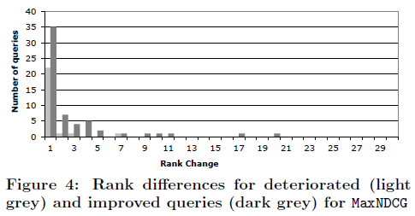
Evaluation Approach - Online Evaluation

Slide 28
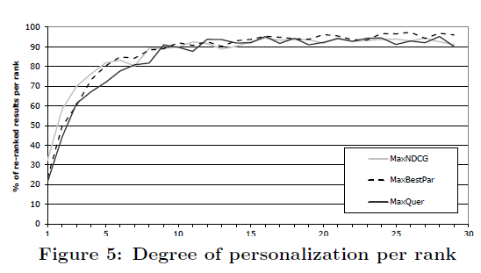
Evaluation Approach - Online Evaluation
MaxNDCG is the most effective personalization strategy according to both our online and offline tests. It performs significantly better than previous best approaches and outperforms the other parameter combinations in the relevance judgement evaluation.

Slide 29
Conclusion & Future Work
Our proposed personalization techniques significantly outperform both default Google ranking and the best previous personalization methods.
The key to using web pages to model users is to treat them as structured documents from which several types of data can be extracted.
There are a number of natural extensions for this work. ex. the set of parameters, temporal information
Using the extracted profiles for purposes other than personalized search.

